Slide 1
DEPARTMENT OF
NETWORKING AND COMMUNICATION
College of Engineering and Technology
SRM Institute of Science and Technology
MINI PROJECT REPORT
EVEN Semester, 2024-2025
Sub code & Sub Name : 18CSE424T & INDUSTRY 4.0 IN SMART AUTOMATION
Year & Semester : Year 3 / Sem 6
Project Title : RADAR using Ultrasonic Sensor and Servo
REFRENCES
WORKING
ABSTRACT
OBJECTIVE
TEAM
CONCLUSION
TITLE
INTRODUCTION

Slide 2
RADAR USING ULTRASONIC
SENSOR AND SERVO
REFRENCES
WORKING
ABSTRACT
OBJECTIVE
CONCLUSION
TEAM
TITLE
INTRODUCTION

Slide 3
DIVYANSH SHUKLA(RA2111031010112)
HARSH YADAV(RA2111031010009)
ABHAY DHAIRAK(RA2111003011362)
KULDEEP RAJPURE(RA2111003011366)
ANSH KALYA(RA21110030111734)
REFRENCES
WORKING
ABSTRACT
CONCLUSION
OBJECTIVE
TITLE
INTRODUCTION
TEAM

Slide 4
REFRENCES
The RADAR is built using Arduino UNO R3 and a C++ code is written and executed. It is built using an Ultrasonic sensor which works by emitting sound waves at a frequency too high to hear for humans.
WORKING
ABSTRACT
OBJECTIVE
TEAM
CONCLUSION
TITLE
INTRODUCTION

Slide 5
The RADAR is built using arduino UNO R3 which connects with the computer and will execute the code given to it and will identify object around it.
This abstract summarizes a project involving radar functionality implemented with an Arduino UNO R3, utilizing an ultrasonic sensor and a servo motor. In this setup, the ultrasonic sensor provides distance measurements while the servo motor enables a scanning motion. Together, they create a basic radar system for detecting and tracking nearby objects.
REFRENCES
WORKING
ABSTRACT
OBJECTIVE
TEAM
CONCLUSION
TITLE
INTRODUCTION

Slide 6
Radar is a fascinating technology that helps us detect objects and measure distances. With just an Arduino Uno R3, an ultrasonic sensor, and a servo motor, you can create a simple radar system. The ultrasonic sensor sends out sound waves, and when they bounce back from an object, it calculates the distance. The servo motor then rotates the sensor, scanning the area and creating a 360-degree view. By connecting these components and writing some code, you can build your own basic radar system that can find nearby objects and display their positions, opening up exciting possibilities for projects and experiments.
HARDWARE/SOFTWARE REQUIREMENTS:
Arduino UNO R3
PC
Bread Board
Ultrasonic Sensor
Servo
Jumper Wires
REFRENCES
WORKING
ABSTRACT
OBJECTIVE
TEAM
CONCLUSION
INTRODUCTION
TITLE

Slide 7
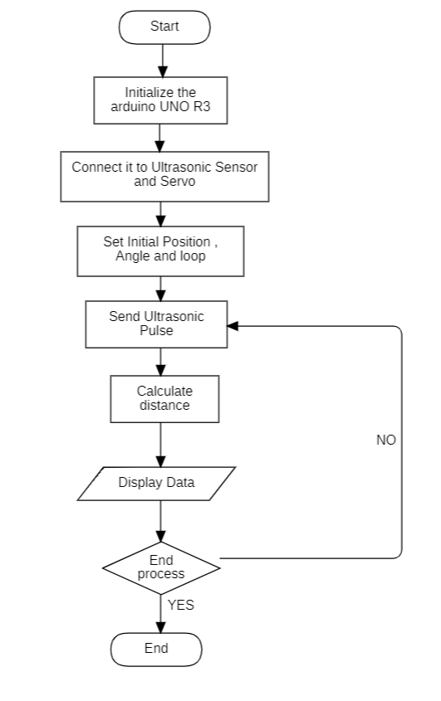
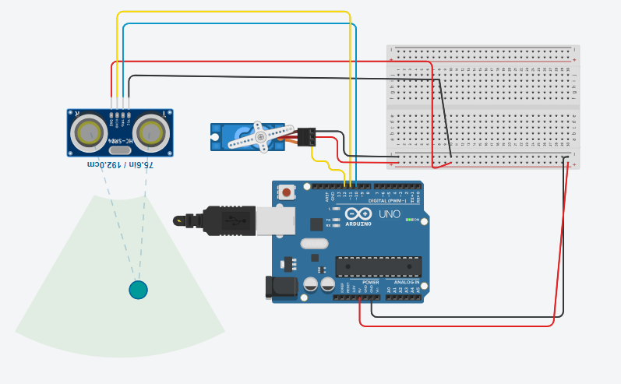
REFRENCES
WORKING
ABSTRACT
OBJECTIVE
TEAM
CONCLUSION
INTRODUCTION
TITLE

Slide 8
Thus the RADAR is constructed and the distance of the object is detected and distance is measured with its range.
WORKING
ABSTRACT
OBJECTIVE
TEAM
CONCLUSION
TITLE
INTRODUCTION
REFRENCES

Slide 9
https://projecthub.arduino.cc/nimishac/ultrasonic-radar-with-arduino-19baa3
WORKING
ABSTRACT
OBJECTIVE
TEAM
CONCLUSION
TITLE
REFRENCES
INTRODUCTION

